Slide 1
The Pennsylvania Horticultural Society motivates people to improve the quality of life and create a sense of community through horticulture.
Notes:
Thank you for attending this webinar/training.
PHS has developed this series of training modules, through grant funding from EPA Region III, in order to help clarify appropriate maintenance techniques for Green Stormwater Infrastructure practices (GSI). It is our hope that the information included here will be helpful for anyone who is learning about SBMPs or is training others about properly maintaining the practices.

Slide 2
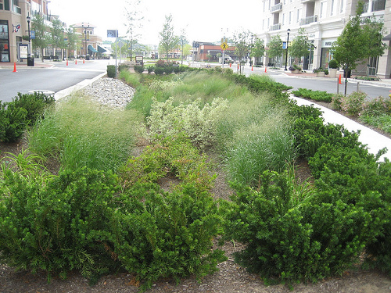
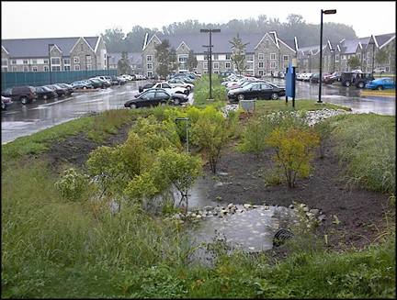
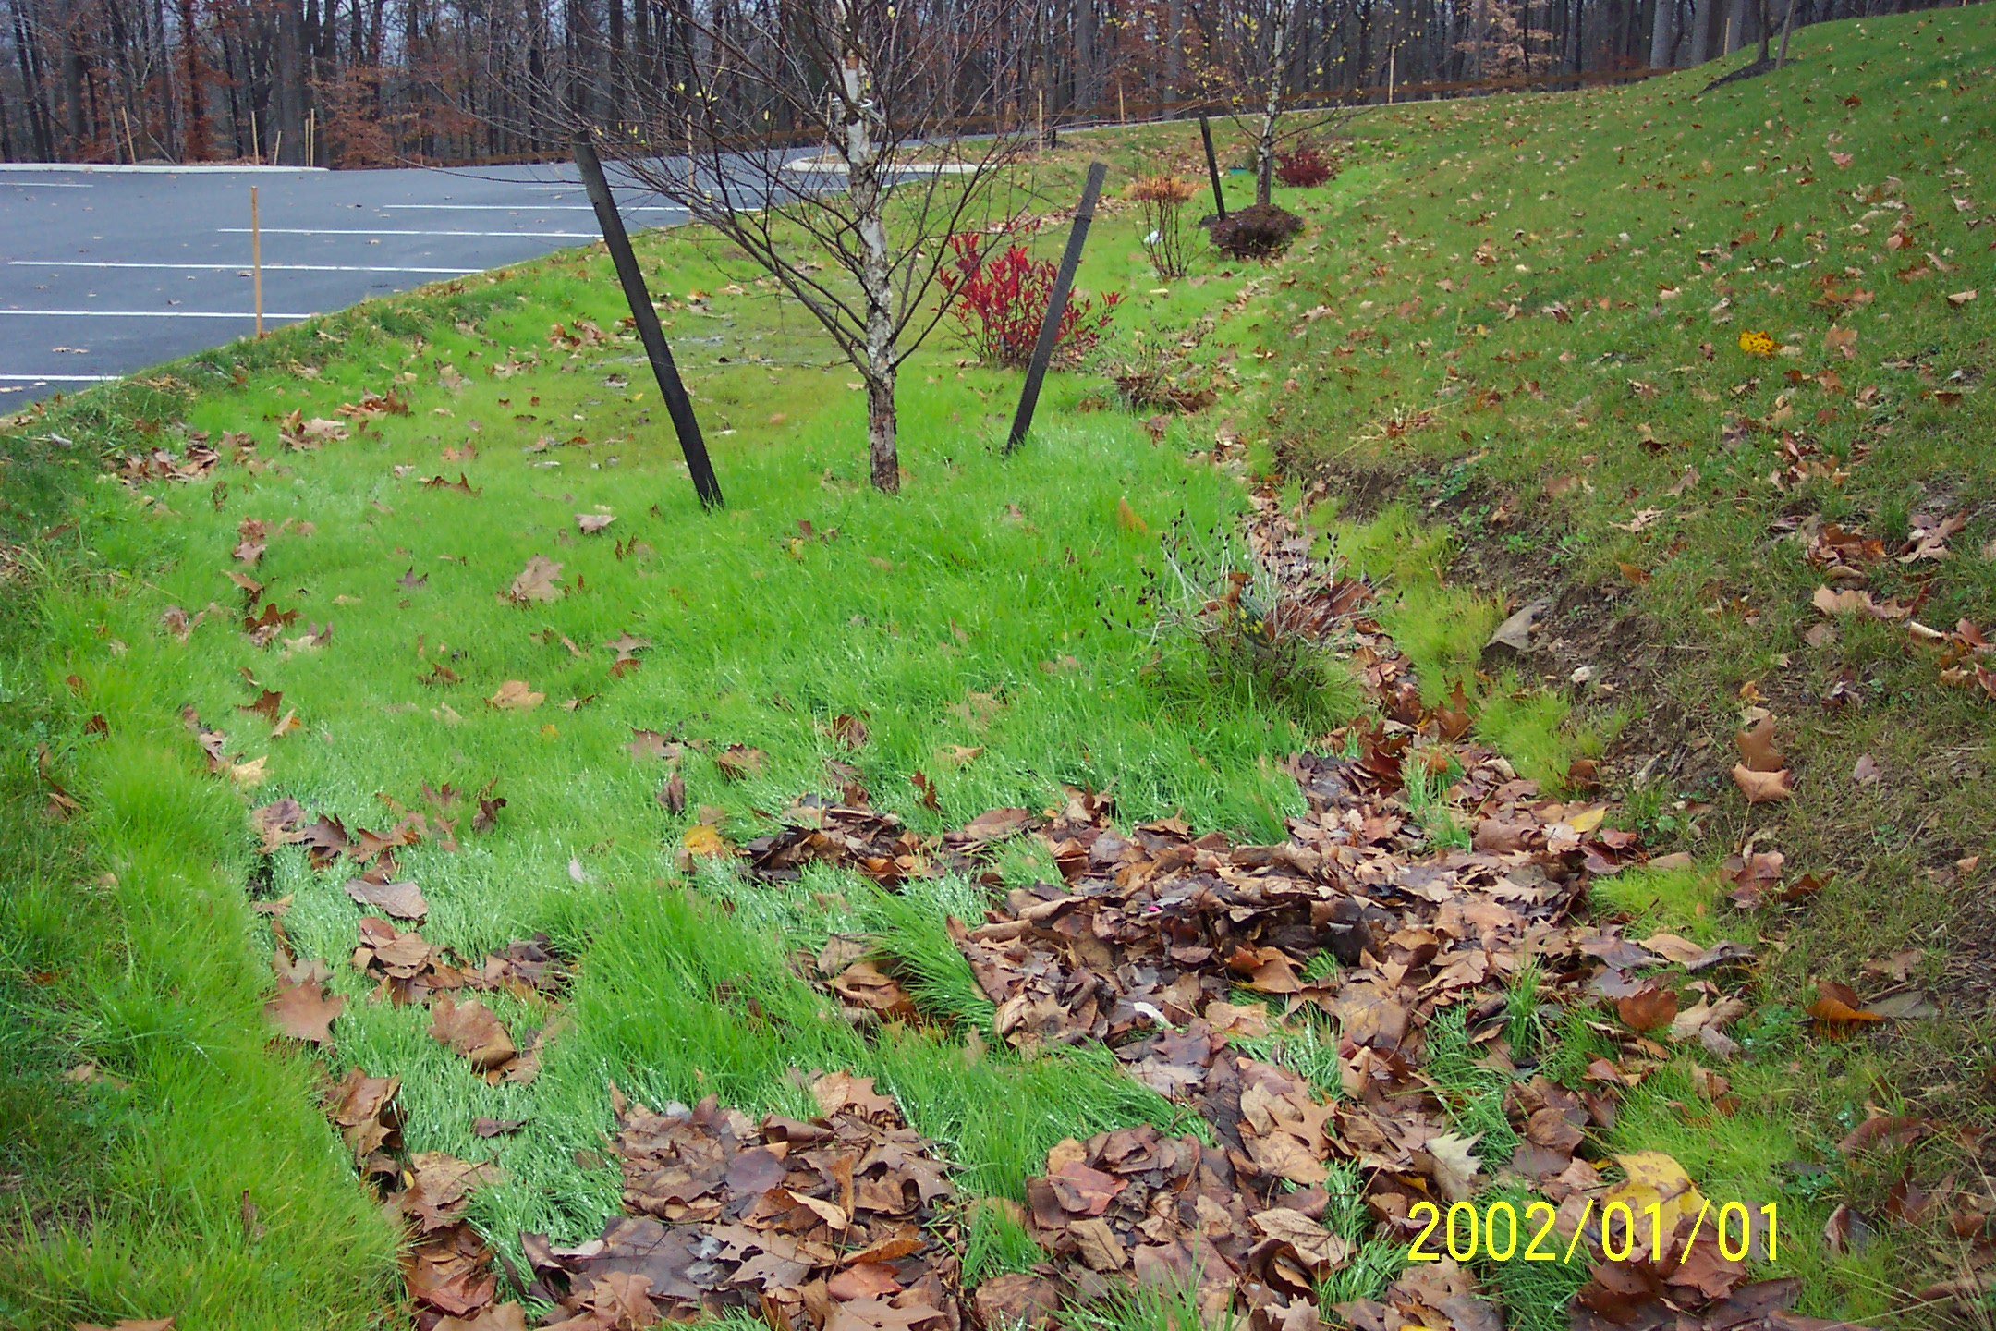
Maintaining Green Stormwater Infrastructure (GSI) Systems
Sustaining green stormwater infrastructure through proper landscape management
Managing surrounding landscapes to the reduce impacts on Green Stormwater Infrastructure
Emma Melvin
PHS Regional Project Manager
Notes:
When managing a bio-retention system, it is important to also consider how to manage the landscape surrounding the system.
Remember: function will always trump aesthetics. It is a priority that these systems are highly functioning with good plant cover to ensure that deep roots will help drain water from the planting bed.

Slide 3
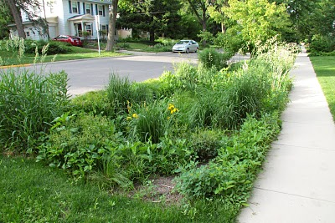
Managing for function and aesthetics
Notes:
Issues that need to be considered include the following:
*Plants naturally die back, and new ones will always grow in the open spaces in the landscape -- including weeds and invasive plants arriving from outside the planting bed.
*Any products such as pesticides or herbicides placed on turf or other plants outside the system will be carried into the bio-retention system along with the stormwater.
*Different landscaping crews may manage different parts of the landscape, and their objectives and techniques need to coordinate.
Decisions need to be made by the maintenance crew about management inside and outside the system in order to sustain a healthy and functioning system.

Slide 4
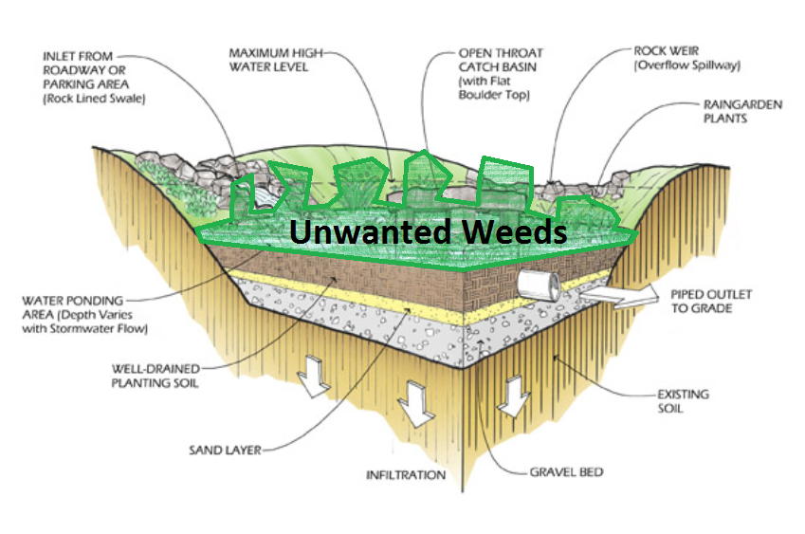
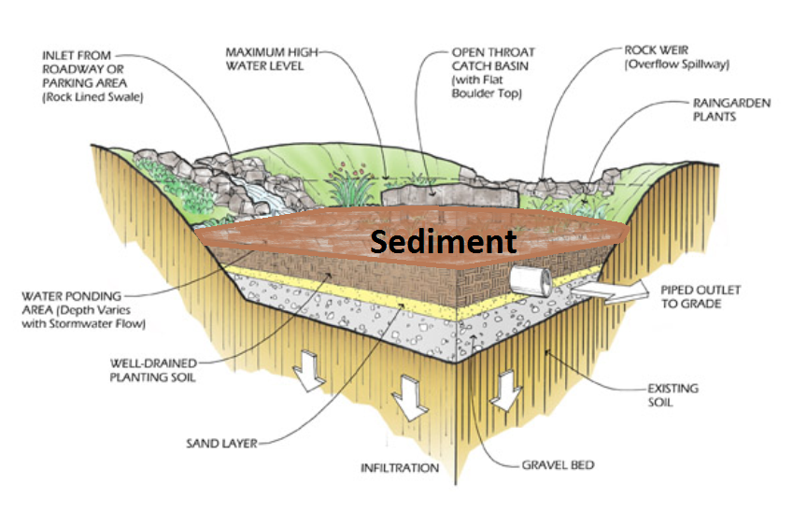
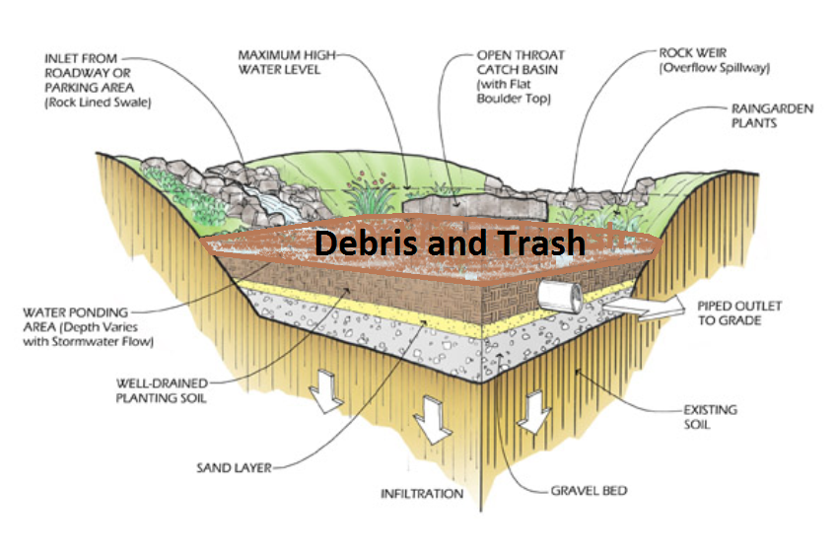
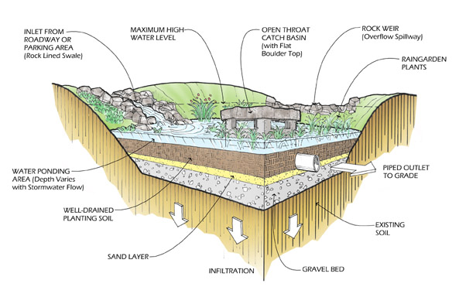
Bio-Retention Systems
Notes:
Sediment, debris and unwanted plant seeds can be carried into the system from surrounding areas.
Weed and invasive plant seeds can be transported by stormwater and animals, from planting beds, turf or woodlands around the site into the bio-retention system. Weeds should be managed in the surrounding landscape so as to reduce the seed bank that can spread into the bio-retention system. Depending on the location of these systems, management practices will vary. For systems located in a highly visible area, management of weeds in the surrounding landscape may require more intense maintenance than for ones in a natural landscape within a park.
We will be talking about ways to minimize the impacts of lawn and garden management on these bio-retention systems.

Slide 5
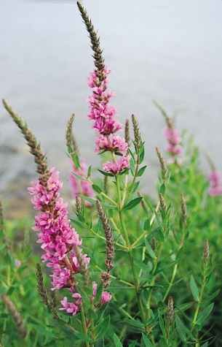
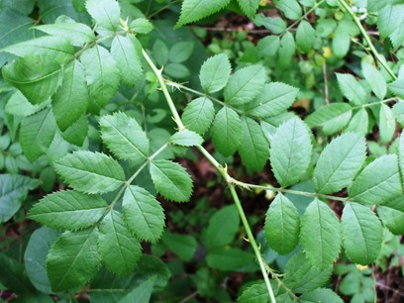
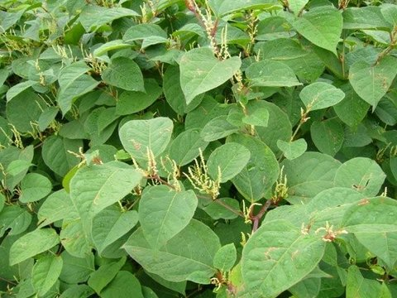
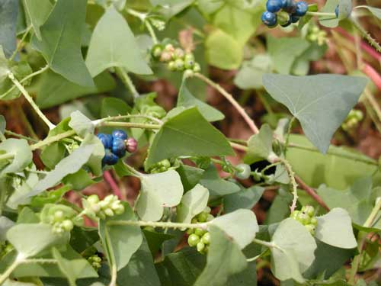
Non-native Invasive Plants
Non-native plants that have an adverse impact on habitats or eco-regions they are introduced to. Ecological impacts include:
Notes:
Non-native invasive plants are plants that are from foreign locations and which have an adverse impact on the habitats or eco-regions they are introduced to. Ecological impacts include:
Disturbing a habitat by dominating and outcompeting native plants for their spot/role in the habitat;
Providing little to no benefit to the animals/plants within habitat or eco-region;
Altering the components of the habitat, including the soils and the presence of native animals/plants within the habitat.
Surrounding landscapes should be monitored for plants that will cause invasive plants to be introduced into the bio-retention system, in addition to spreading to other natural systems including streams and rivers and woodlands.

Slide 6
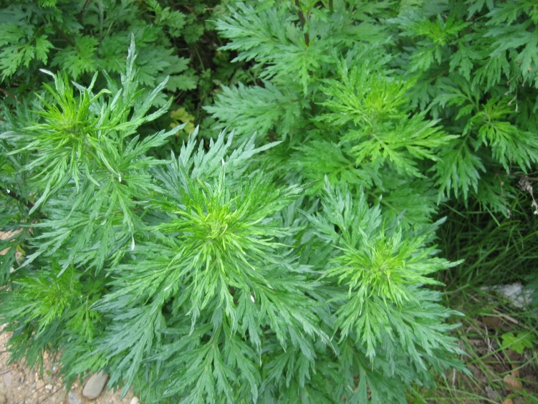
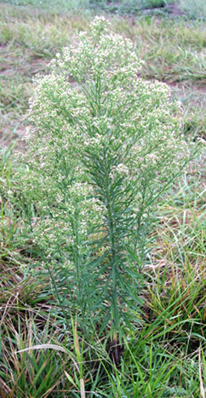
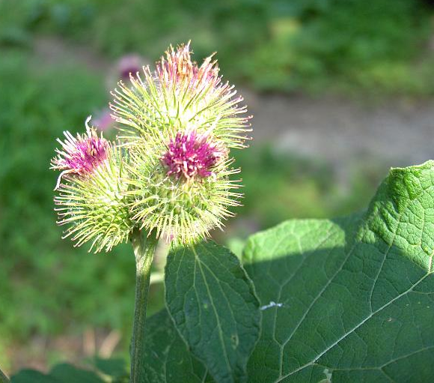
Weed Plant
A plant that was not planted by the gardener, that is not valued where it is growing and is usually of vigorous growth that tends to overgrow or choke out more desirable plants.
Ex. Dandelions, crab grass in a garden, broadleaf and plaintains
Notes:
Weeds are plants that are not in the “right” location, i.e. which were not planted by the gardener. They are generally not valued where they are growing and are usually of vigorous growth. Especially problematic are the invasives (whether native or exotic): ones that tend to overgrow or choke out more desirable plants. These should be managed to achieve whatever certain appearance the owner is hoping to attain. In a gateway or highly visible location, weeds in and outside the system should be removed to reduce the spread of the seeds into the bio-retention system.

Slide 7
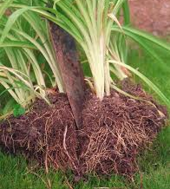
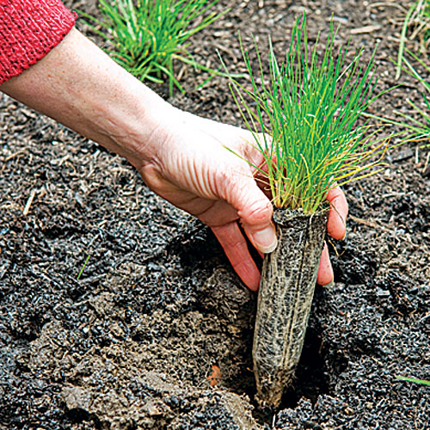
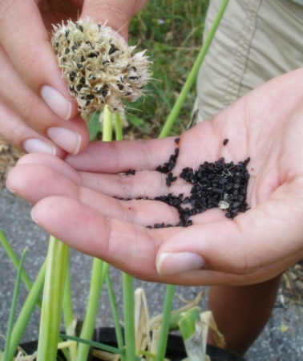
Filling out the Planting Bed
Un-compact planting bed soil
Divide thriving plants
Remove weeds and dead plants
Add plant plugs
Replant divided plants
Collect seeds &
disperse throughout
garden
Pruning only broken or damaged branches
Notes:
Keeping the bio-retention area full of thriving plants will reduce the impact of weed and invasive plant seeds entering the garden. If plants die back in certain areas, replant. Bare areas give weeds and invasive plants an opportunity to invade the planting bed. When conducting maintenance on a site, assess the health of all plants, divide any plants that are thriving and spreading, and use them to fill in areas where plants have died. Weed out any unwanted plants and remove any dead plants. If the system is new, with small plants that are not ready to be divided, add small plants -- called plugs -- to fill in any open areas. In the fall, collect the seeds of plants and disperse them throughout the garden to ensure the spread of desirable plants. Prune only dead or damaged stems or branches. Trees and shrubs should be pruned for proper structure only in the dormant period.

Slide 8
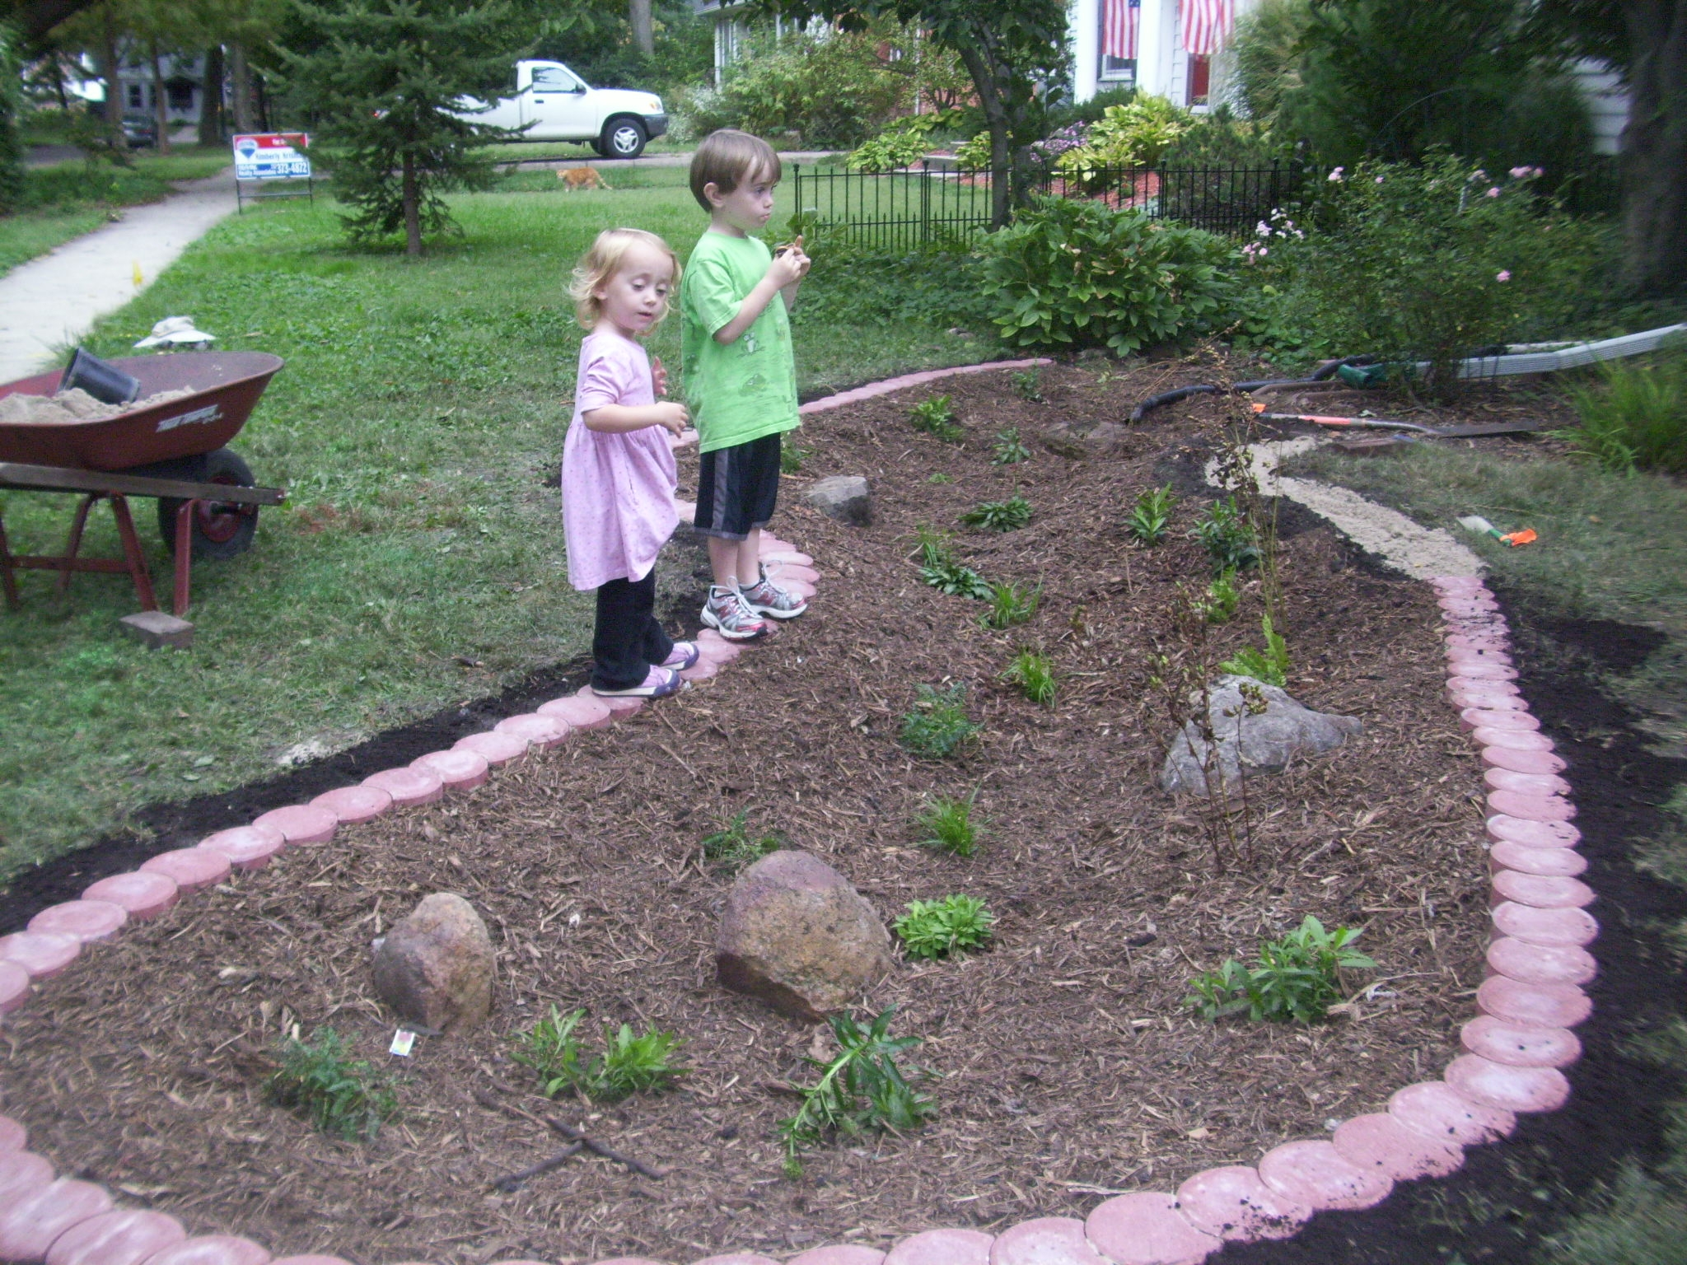
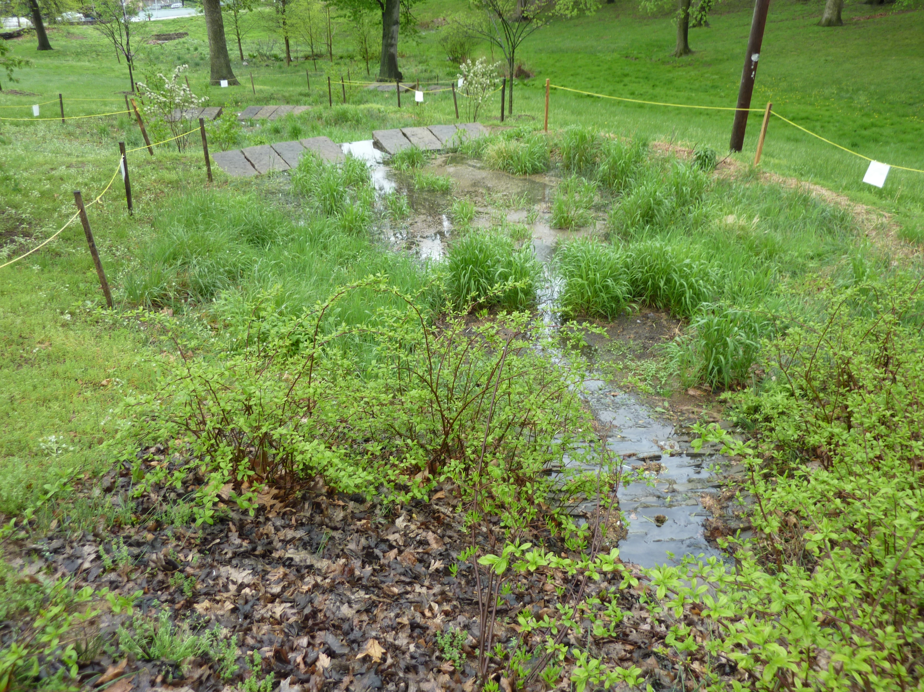
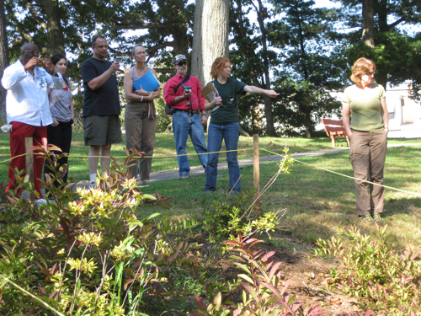
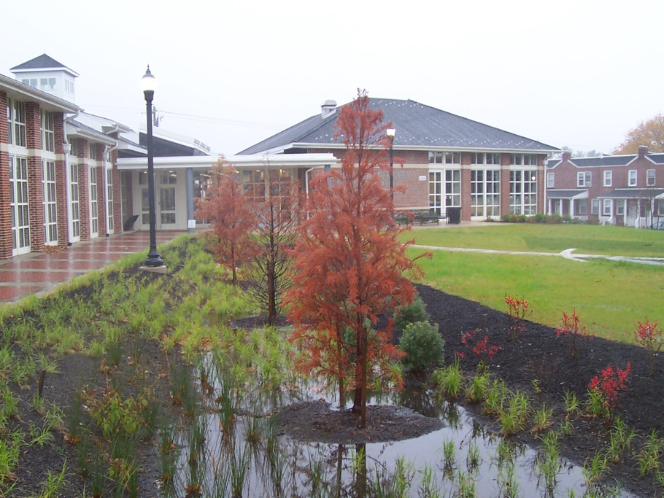
Working outside the system
Delineating bio-retention area from turf
Notes:
When the bio-retention systems are managed by a different person or landscape company than the surrounding landscape, it is important to delineate the perimeter of the functioning garden. This is especially critical in systems with a minor depression that contain perennial grasses and with turf as the adjacent land cover, because it may be hard to differentiate the types of grasses. Delineating the bio-retention system is important during the growing season as well as in the fall to avoid mowing issues and to ensure that any management activities are not causing a barrier to the water flow into the garden.

Slide 9
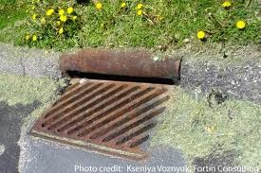
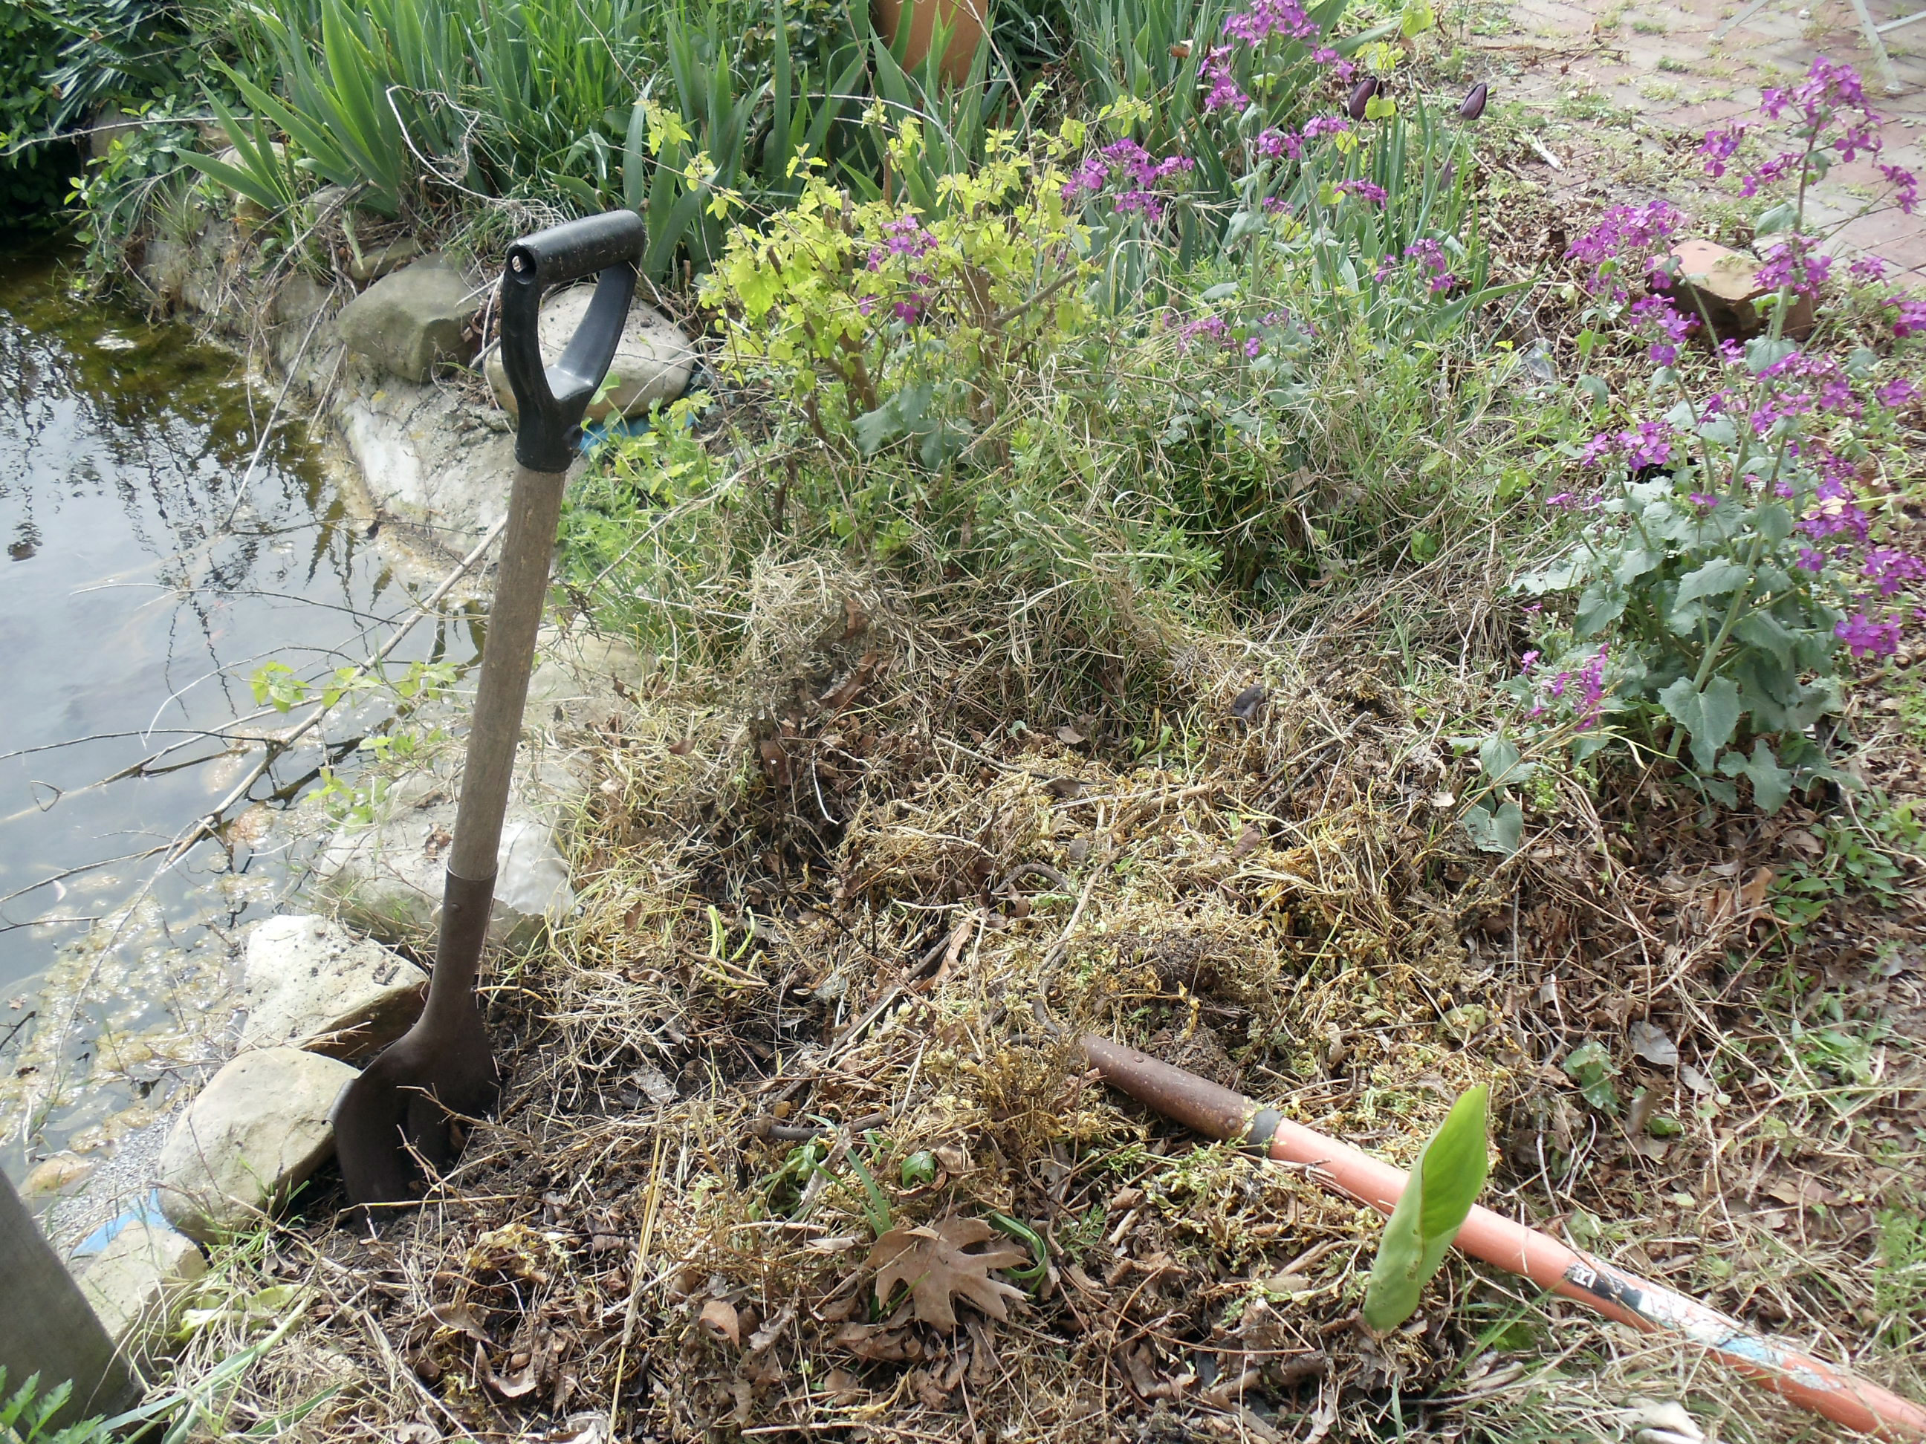
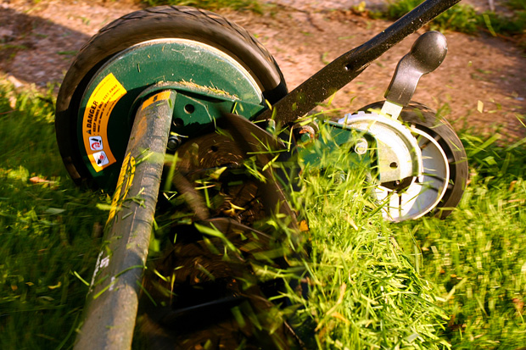
Working outside the system
Turf management
Notes:
When mowing, ensure that all the clippings are left on the lawn and not sprayed into the garden.
When cleaning walkways, always collect clippings and either place them back onto the lawn or into the garbage. These grass clippings will add nutrients to the system as they decompose.

Slide 10
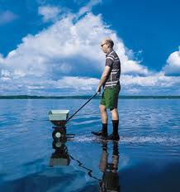
Working outside the system
Turf management
Fertilizer and Herbicide Application
Notes:
With regard to fertilizer and herbicide:
--Timing is key– both are moved by water, so applying before rain will cause both to be washed off with stormwater into the bio-retention systems.
--Both can have a negative impact on the system.
--If possible do not use these products around bio-retention systems. If you must use them, be sure to apply only the prescribed amount, which will quickly be absorbed by the targeted plants.
--Never use them within the system, unless you need to eliminate an invasive plant that has overrun the system and no other management technique is possible.

Slide 11
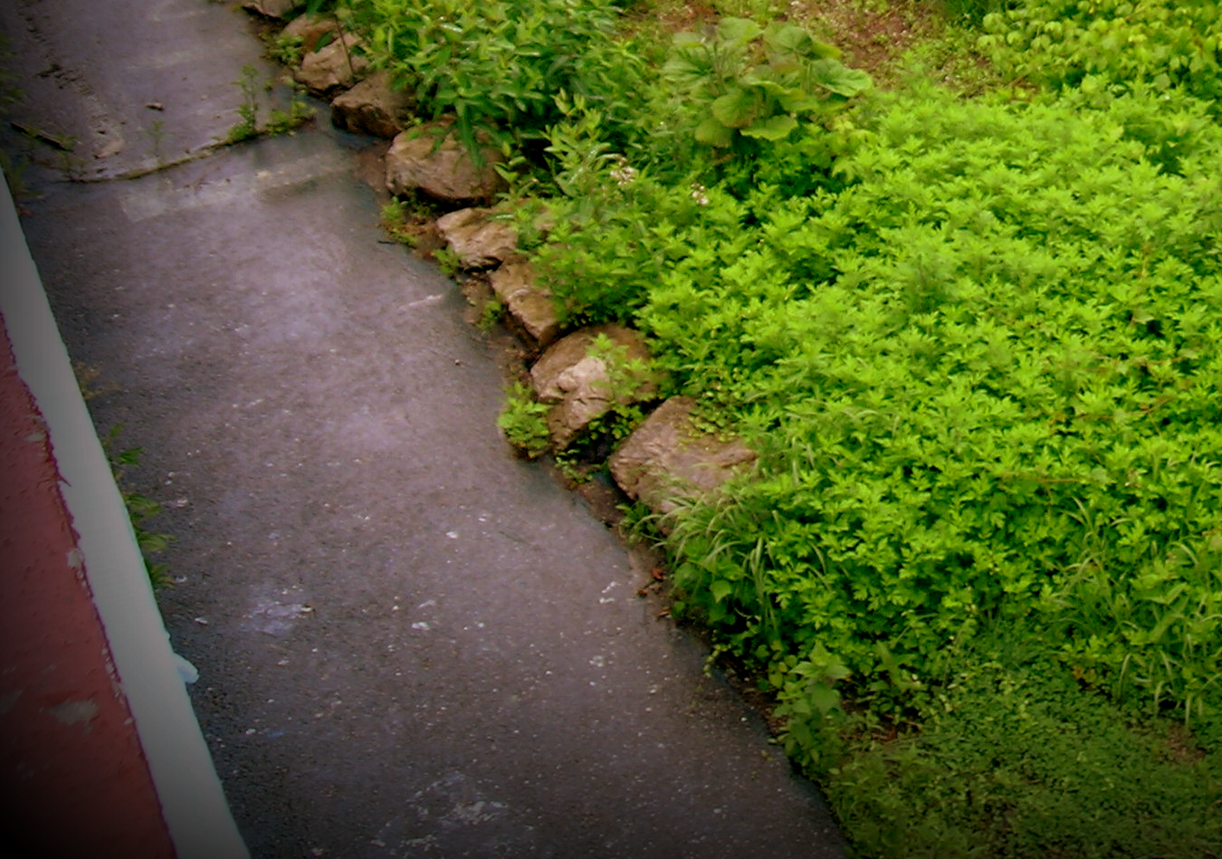
Tidying up around the system
Notes:
Ensure that none of the practices around the outside of the basin will impact its function. It is important not to brush or sweep any debris into the basin components, either through the entrance, planting bed or outlet.

Slide 12
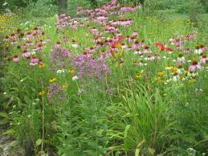
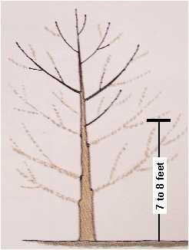
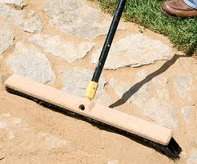
Maintenance for cosmetic vs. functionality
Maintain the balance between tidying up and disturbing functionality
Naturalized garden setting:
Tall, disorganized and evolving
Within the garden, allow plants to grow in a natural form. Only change their form if causing issues outside the system.
Notes:
The cosmetic look of the system must be balanced with its functionality. The garden can be formal or naturalized – as long as the bio-retention function of the working landscape is not compromised.

Slide 13
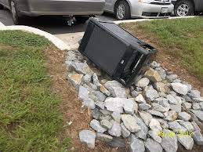
At the end of a work session
Ensure entrance is clear of debris, sediment or other material
Ensure no material/soil/plant debris is blocking the flow through the garden
All soil within the garden is level
Notes:
The same is true when completing your final inspection of the work. Again, the function of the system is paramount and nothing must impede its efficiency. Generally, a carefully maintained bio-retention system will also be pleasing to the eye and a welcome addition to any landscape.

Slide 14





THANK YOU TO OUR
FUNDER & PARTNERS

Slide 15
Next up……………….
How is your town planning to manage stormwater?
Notes:
This is the last module in the series. The next step is to discover how YOUR town plans to manage their stormwater.

